Slide 1

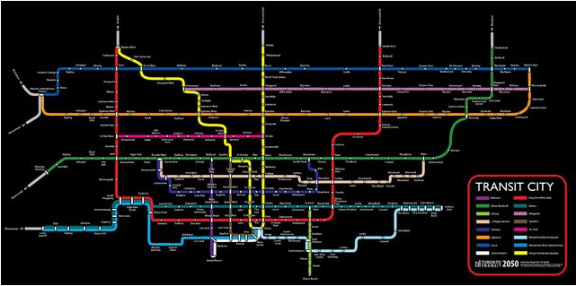
3250 Term Project-Group H
TTC Ridership Analysis
Team Members:
Ashokkumar Mistry
Diem Anh Nguyen
Md Mominur Rahaman
Muhammad Raza

Slide 2
Agenda
Introduction
Overview on Data Set and Objective of Data Analysis
List of Method- Functions applied for our analysis
Data Preparation
Data Analysis
Opportunities on further analysis
Conclusions
Q & A

Slide 3
Introduction
Data Source: City of Toronto Open Data Website ‘TTC Ridership’
Our Approach
Explore different data sources
Discuss and finalize dataset
Split of responsibility
Use BitBucket to collaborate on coding and share files
Collaboration- Team meetings, Conference Call
Challenges
Choosing Data-Set
Format & display data
Timeline , Parallel to our class assignments
Adapt learnings about Python
Collaboration and different points of view
Why TTC
TTC impacts our life on a regular basis
TTC Ridership dataset had a sufficient number of years of data and attributes

Slide 4
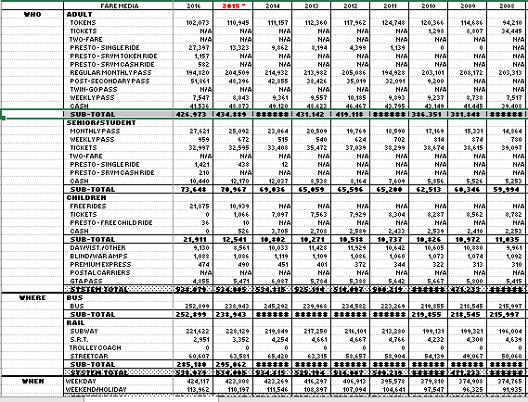
Overview: Data Set and Objective on Analysis
Question: What should the TTC focus their efforts on in the near future?
Our Objective
Analyze trend for overall ridership and revenue
Forecast on ridership and TTC revenue
Trend analysis based on passenger type
Trend analysis based on Fare Media
Trend Analysis based on types of vehicles
Trend analysis on Peak vs Non-Peak hours
Finding Autocorrelation on each attribute
Using regression and ARIMA to define a model and vet the model with test dataset
NB. See Appendix A to know about Data Attribute

Slide 5
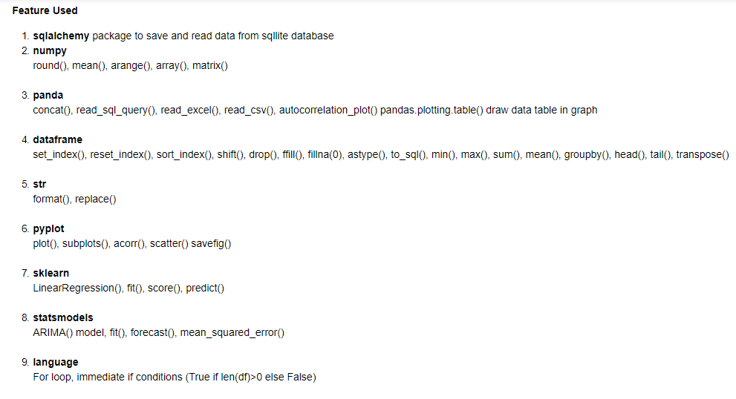
Tools & List of Method being Used
Data perusal- Excel, CSV
Data Manipulation: Anaconda, Jupyter Notebook, Python’s Pandas, Matplotlib and Numpy Libraries
Group Collaboration: Atlassian’s BitBucket (github)

Slide 6
Data Preparation
Read data (excel/CSV) in Pandas DataFrame ,Cleanup
Renaming the column
Filling Missing Values and Converting float values to Integer
Label each row for ridership
Creating new column
Dropping unnecessary rows
Transposing Rows
Build sqllite tables to store cleaned data
Fetch data from sqllite table in next run
*Benefits - Data will be cleaned up only first time of running our python code

Slide 7
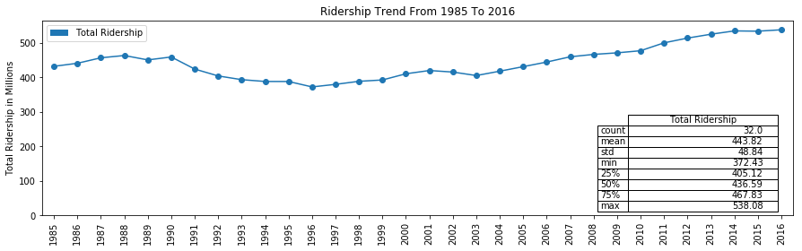
Ridership Analysis-Aggregate
TTC Ridership had stagnated with the existing services. This may be due to a number of factors:
Rise of Uber as an option
Availability of BIXI, cycle rider program
Rise of cycling in general
Low gas prices throughout 2015
Economic growth in Toronto encourages to purchase own car and driving.
Working from Home Program
Streetcar fare evasion

Slide 8
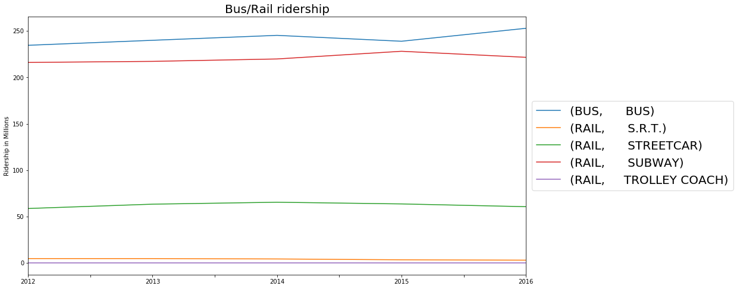
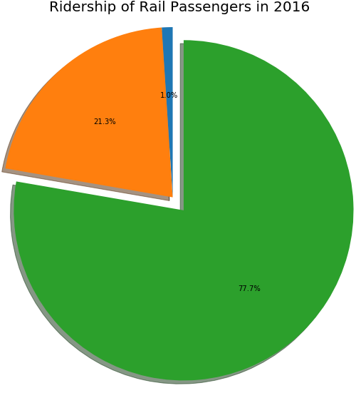

Ridership Analysis-Vehicles Type
Riding in Bus is significant
More than 75% ride in Rail are Subway based

Slide 9
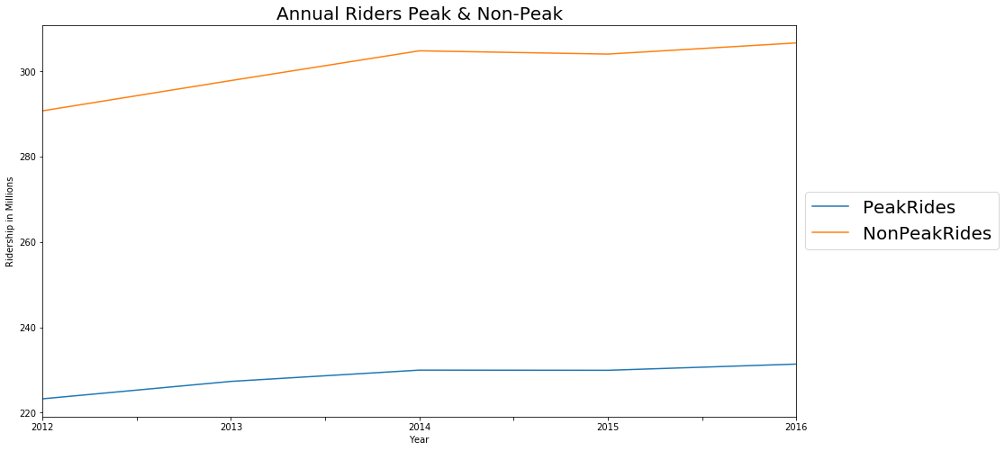
Peak vs. Non Peak
Growth trend for Peak vs. Non-Peak are very similar
Quite high in 2014 but both dropped dramatically in 2015 and started picking up again thereafter
Drop in 2015 mainly due to
Slowing economy and employment
Fare increase and fare evasion
Lower gas prices, the increase in popularity of Uber

Slide 10
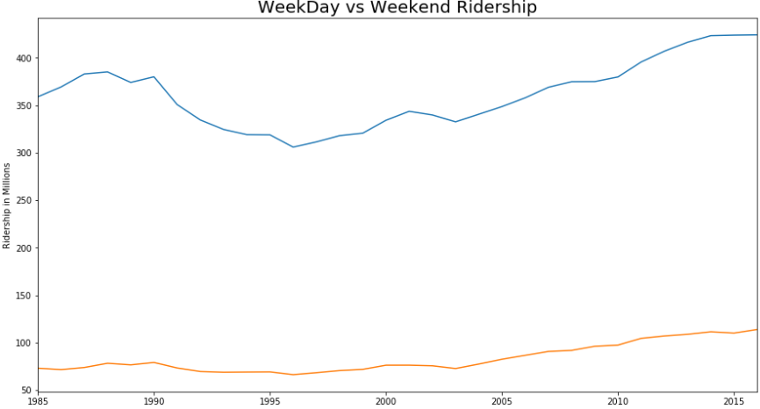

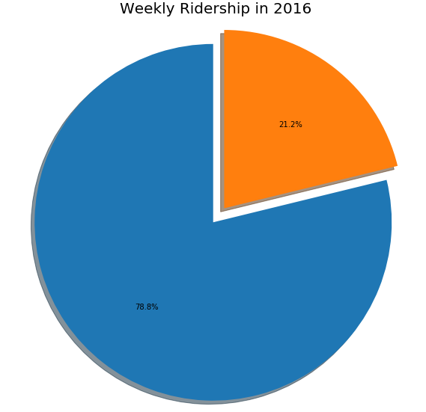
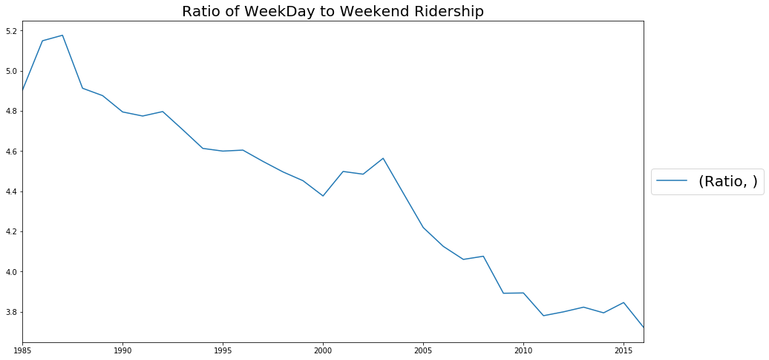
Ridership Analysis-Weekday vs Weekend/Holidays
Weekday to Weekend/holidays ratio decremental from year 1987 though ridership trend incremental in year to year
weekday ridership drop in 1990 possibly due to recession but began to pick up again in 2004
Revenue Opportunity by offering in Weekend/Holiday Ride

Slide 11
Ridership Analysis- Passenger Type
TTC Riders are mostly Adult
3% of Ridership are categorized as Others (GTA Pass, Family Pass..)
Many factors/de-factors in ridership trend in year to year
Population increases
Introducing more route, vehicle , frequent schedules
Growing trend in private vehicles, carpooling
Adult ridership has been going up since 1996
Children under the age of 12 can ride the TTC for free from 2015

Slide 12
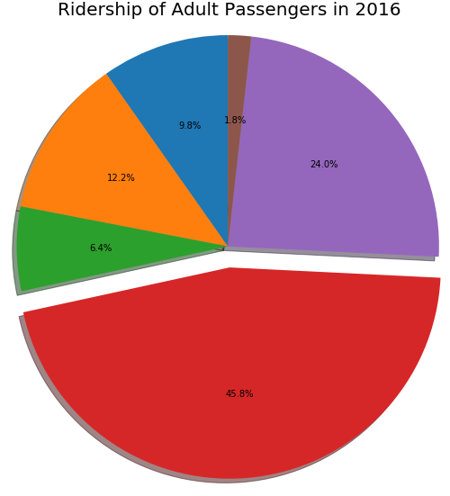
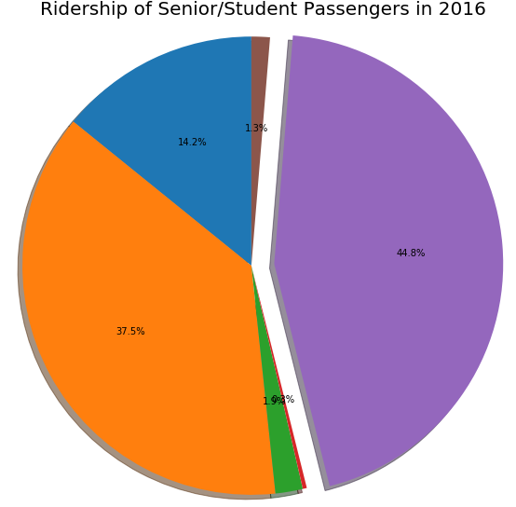


Ridership Analysis- Fare Media
Popular Fare Media
Monthly pass for Adult
Tickets for Seniors/Students, whereas they are using monthly pass in almost similar level
Free for Children
Presto usage increases recently

Slide 13
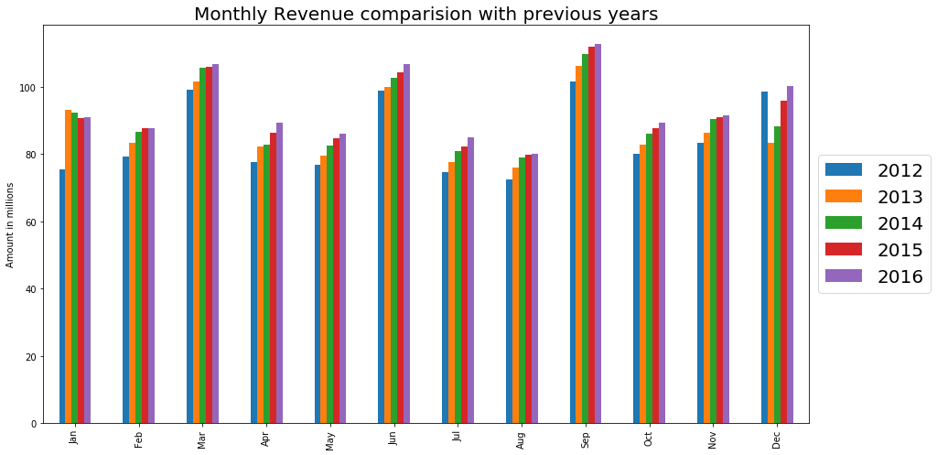
Ridership Analysis-Revenue Wise
Seasonal Plot shows that Revenue Generating Months are March, Jun, September, December

Slide 14
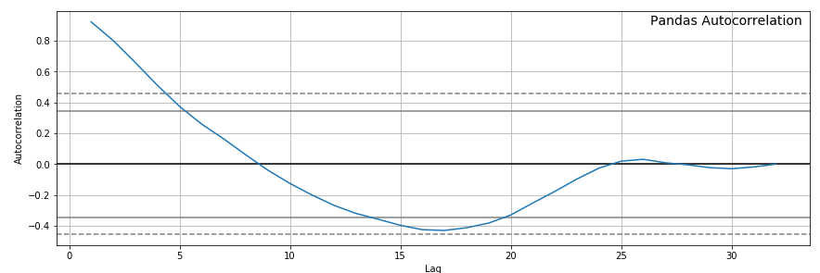
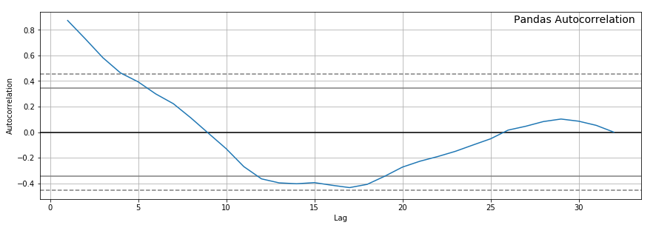
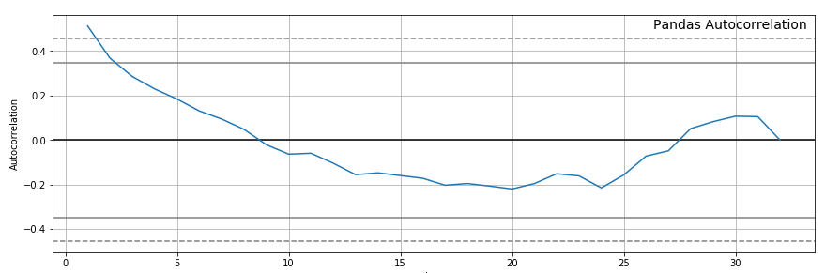
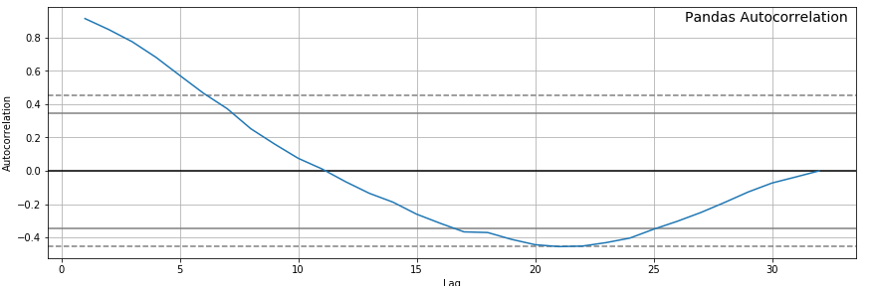
Autocorrelation- Passenger Type
Adult
Seniors/Students
Others
Children
Passenger types are autocorrelated
Adults, Senior/Student and Others are statistically significant, having autocorrelation for about 5-years
Children are not significant in terms of autocorrelation

Slide 15
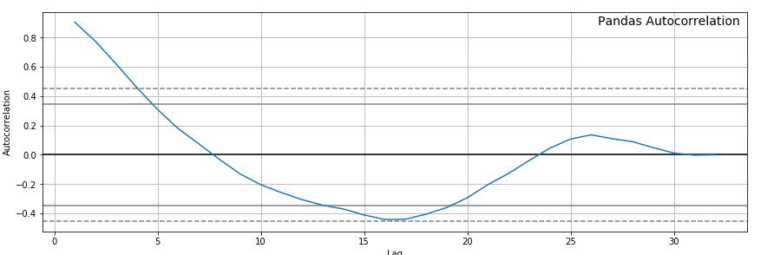
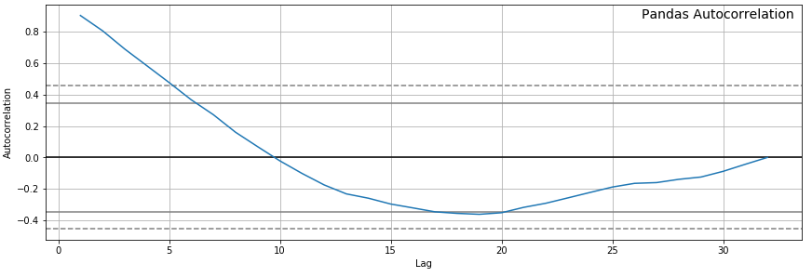
Autocorrelation- Weekday & Weekend
WeekDays
Both attributes are statistically significant, having autocorrelation for about 5-years
WeekEnd/Holliday

Slide 16
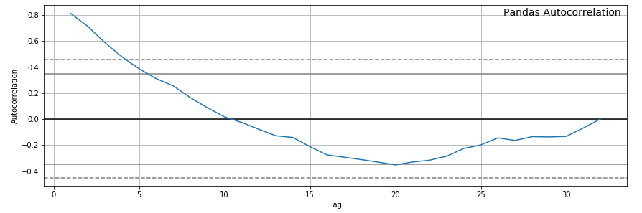
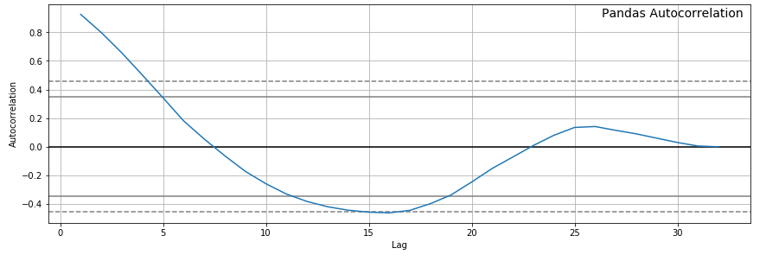
Autocorrelation-Vehicles
BUS
Both BUS and RAIL ridership are statistically significant
RAIL

Slide 17
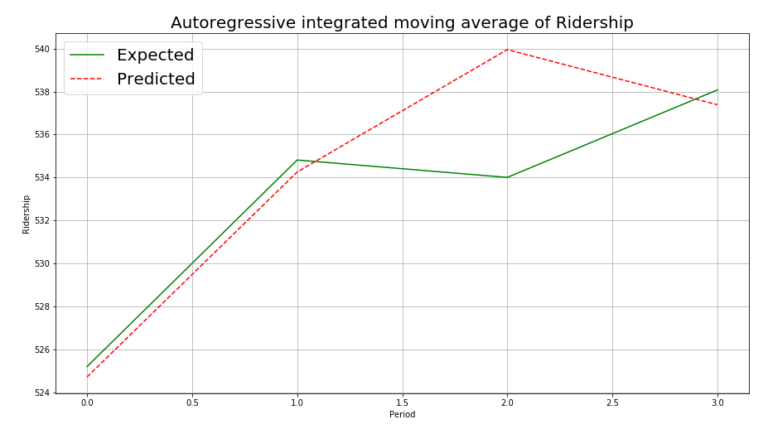
Ridership Analysis-ARIMA Model
ARIMA- Autoregressive Integrated Moving Average
https://machinelearningmastery.com/arima-for-time-series-forecasting-with-python/
Test Mean Squared Error: 9.112 %

Slide 18
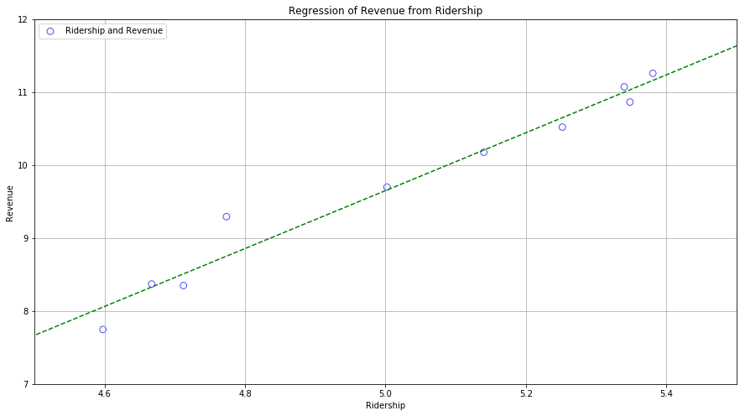
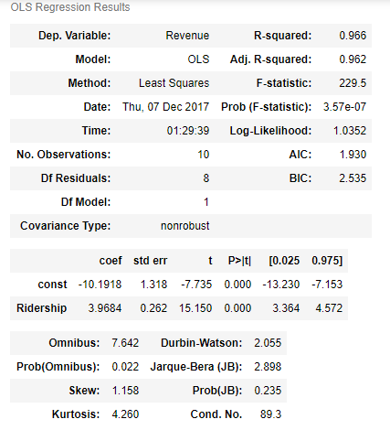
Ridership Analysis-Regression Model
Revenue= -10.19 + 3.96*Ridership

Slide 19
Opportunities on Further Analysis
Further Opportunities lies upon other data availability, Depending on it- More things to derive
Weekend/Holiday Offer and more frequency to cater more ridership
Vehicle scheduling , Route Planning
Offer on passenger type based on TTC business goals

Slide 20
Conclusion
Data Analysis Aspect
Increasing trend for passenger ridership for adults, children, senior/students
Interestingly, each group have a different dominant method of payment
Consistent high level of autocorrelation for approximately 5 years for each passenger type (except children) and Weekday, Weekend/Holiday
An evident seasonal trend with ridership where there is a peak in March, June, September, and December.
Group Performance
Successfully applied our Knowledge learned from Data Science Foundation -3250
Develop our skill set on Data Cleaning, Transposing, Analyzing, Mapping and Statistical Modeling
Great-Team work, Exchanging individual skills to others
Able to figure out opportunity on further analysis depending on availability of other data type

Slide 21


Slide 22
Backup Slide

Slide 23
Appendix A- Data Attribute
Name | Description | Comments
2016 - 1985 | This matrix shows the number of riders recorded under each column from 1985 to 2016. Each figure should have three zeros after each number. | Add three zeros to the end of each number. 112,360 is actually 112,360,000 tokens received from riders.
Fare Media | This lists the different forms of fares (payment) accepted by the TTC. | Tokens, tickets, PRESTO, monthly/weekly passes, cash
Who | This lists the different types of types of fares payable by different groups of riders | Adult – Tokens, Tickets, PRESTO, Regular Monthly Pass, etc. Children – Tickets, PRESTO, cash
Where | This identifies the types of vehicles being used to transport riders | Bus, subway, SRT, streetcar
When | This indicates by year the number of riders during a weekday or weekend/holiday

Slide 24
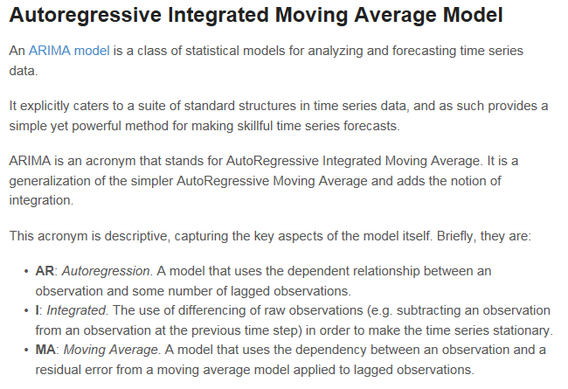
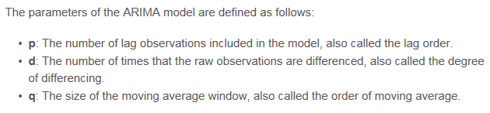
ARIMA Model
https://www.slideshare.net/21_venkat/arima-26196965

Slide 25
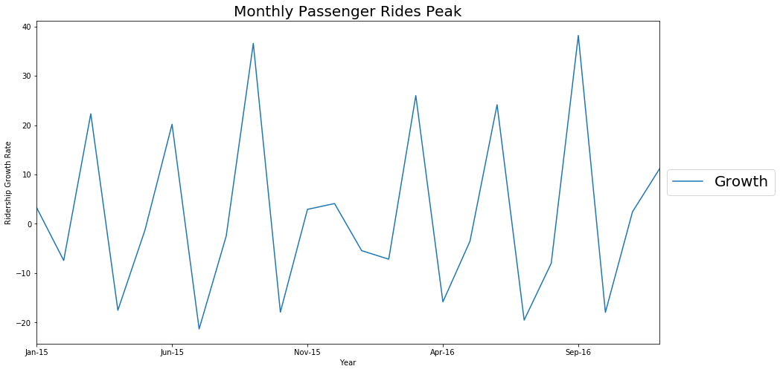
Ridership Analysis-Monthly Ridership

